Slide 1
Embedded Systems with ARM Cortex-M Microcontrollers in Assembly Language and C
Chapter 11
Interrupt, Timer and PWM
Exercises ANS
Z. Gu
Fall 2025
Acknowledgement: Lecture slides based on Embedded Systems with ARM Cortex-M Microcontrollers in Assembly Language and C, University of Maine https://web.eece.maine.edu/~zhu/book/

Slide 2
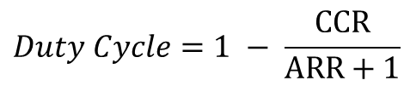

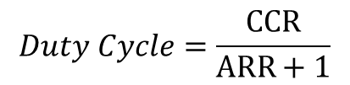
Summary of Equations
Timer clock frequency $f_{CK_CNT}$ vs. CPU Clock Frequency $f_{SOURCE}$
$$f_{CK_CNT}=\frac{f_{SOURCE}}{PSC+1}$$
Timer frequency $fTimer$ with up-counting or down-counting mode:
$$fTimer=\frac{f_{CK_CNT}}{ARR+1}; Timer Period=\frac{ARR+1}{f_{CK_CNT}}= \left(ARR+1\right)∗Clock Period$$
Timer frequency $fTimer$ with center-aligned counting mode:
$$fTimer=\frac{f_{CK_CNT}}{2∗ARR};Timer Period=\left(2∗ARR\right)∗Clock Period$$
PWM duty cycle for Mode 1 (Low-True):
$$Duty Cycle=\frac{CCR}{ARR+1}$$
PWM duty cycle for Mode 2 (High-True):
$$Duty Cycle=1 − \frac{CCR}{ARR+1}$$

Slide 3
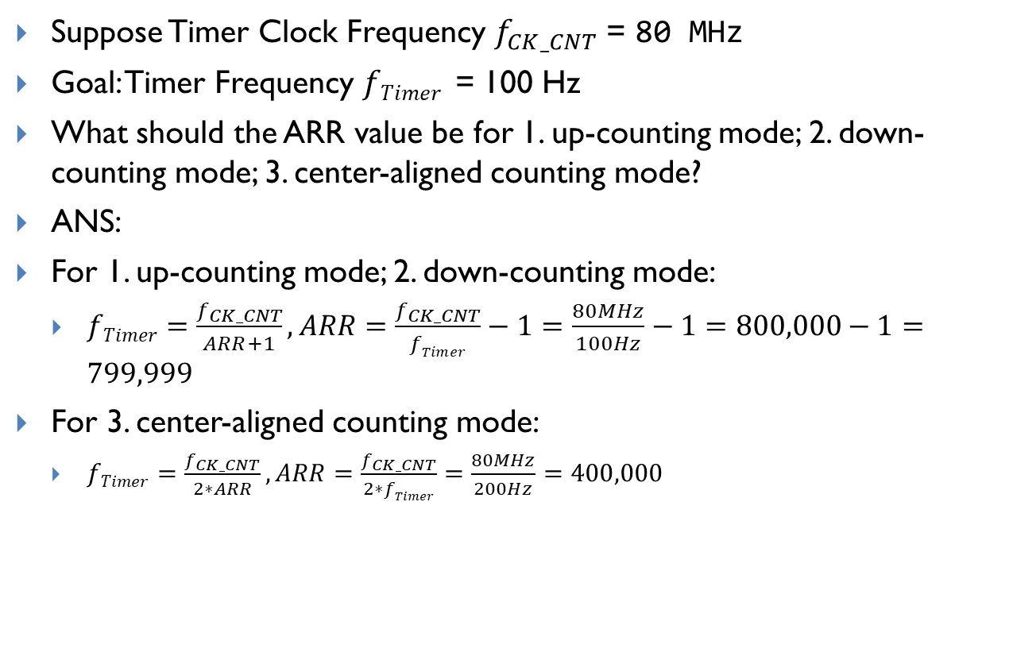
Calculating ARR
Suppose Timer Clock Frequency $f_{CK_CNT}$= 80 MHz
Goal: Timer Frequency $fTimer$ = 100 Hz
What should the ARR value be for 1. up-counting mode; 2. down-counting mode; 3. center-aligned counting mode?
ANS:
For 1. up-counting mode; 2. down-counting mode:
$fTimer=\frac{f_{CK_CNT}}{ARR+1}, ARR=\frac{f_{CK_CNT}}{fTimer}−1=\frac{80MHz}{100Hz}−1=800,000−1=799,999$
For 3. center-aligned counting mode:
$fTimer=\frac{f_{CK_CNT}}{2∗ARR}, ARR=\frac{f_{CK_CNT}}{2∗fTimer}=\frac{80MHz}{200Hz}=400,000$
Notes:
{{Pause=2}} Suppose the clock source that drives the timer counter has a frequency of 80 MHz. We want to generate a SysTick interrupt every 10 milliseconds. What is the reload value? {{Pause=2}} Here is the diagram of SysTicks. {{Pause=0.5}} This is the clock signal, which has a frequency of 80 MHz. A SysTick interrupt is generated every 10 milliseconds. {{Pause=0.5}} An interrupt is generated when the counter makes the transition from 1 to 0. {{Pause=1} It takes a total of, reload plus 1, cycles to count down from the reload value to 0. {{Pause=0.5}} The reload value is calculated in this way. Reload value equals to 10 milliseconds, divided by the clock period, minus 1. This is equivalent to 10 milliseconds, multiply the clock frequency, minus 1. {{Pause=0.5}} The final result is 799999.

Slide 4
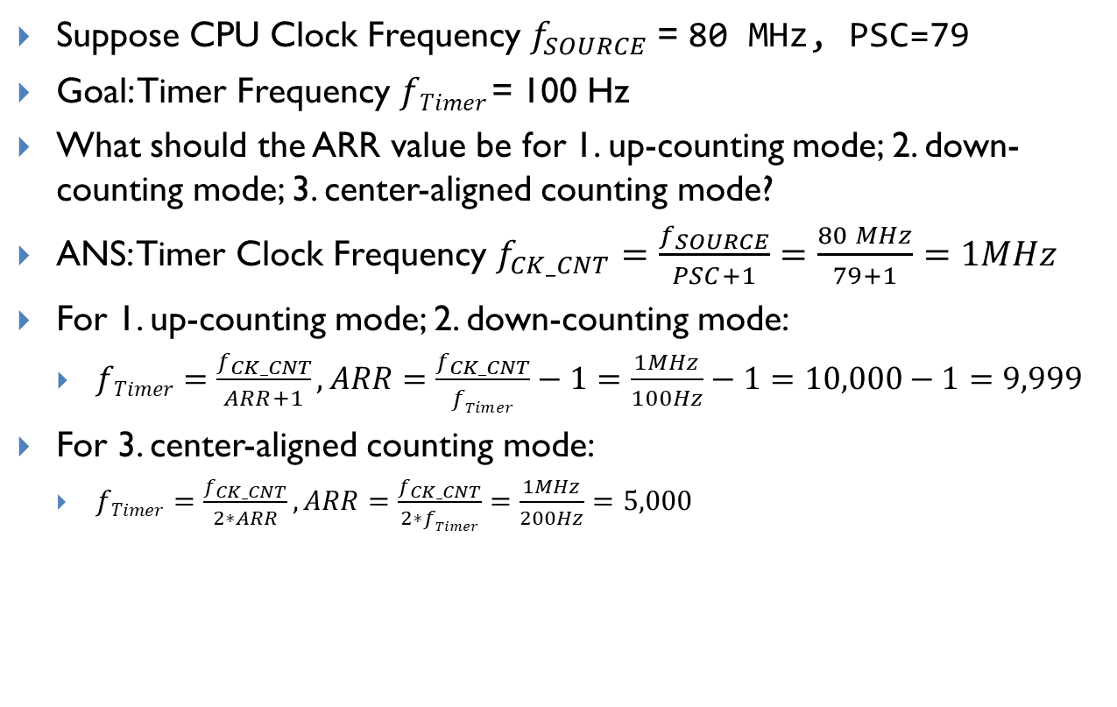
Calculating ARR with prescaler
Suppose CPU Clock Frequency $f_{SOURCE}$= 80 MHz, PSC=79
Goal: Timer Frequency $fTimer$= 100 Hz
What should the ARR value be for 1. up-counting mode; 2. down-counting mode; 3. center-aligned counting mode?
ANS: Timer Clock Frequency $f_{CK_CNT}=\frac{f_{SOURCE}}{PSC+1}=\frac{80 MHz}{79+1}=1MHz$
For 1. up-counting mode; 2. down-counting mode:
$fTimer=\frac{f_{CK_CNT}}{ARR+1}, ARR=\frac{f_{CK_CNT}}{fTimer}−1=\frac{1MHz}{100Hz}−1=10,000−1=9,999$
For 3. center-aligned counting mode:
$fTimer=\frac{f_{CK_CNT}}{2∗ARR}, ARR=\frac{f_{CK_CNT}}{2∗fTimer}=\frac{1MHz}{200Hz}=5,000$
Notes:
{{Pause=2}} Suppose the clock source that drives the timer counter has a frequency of 80 MHz. We want to generate a SysTick interrupt every 10 milliseconds. What is the reload value? {{Pause=2}} Here is the diagram of SysTicks. {{Pause=0.5}} This is the clock signal, which has a frequency of 80 MHz. A SysTick interrupt is generated every 10 milliseconds. {{Pause=0.5}} An interrupt is generated when the counter makes the transition from 1 to 0. {{Pause=1} It takes a total of, reload plus 1, cycles to count down from the reload value to 0. {{Pause=0.5}} The reload value is calculated in this way. Reload value equals to 10 milliseconds, divided by the clock period, minus 1. This is equivalent to 10 milliseconds, multiply the clock frequency, minus 1. {{Pause=0.5}} The final result is 799999.

Slide 5
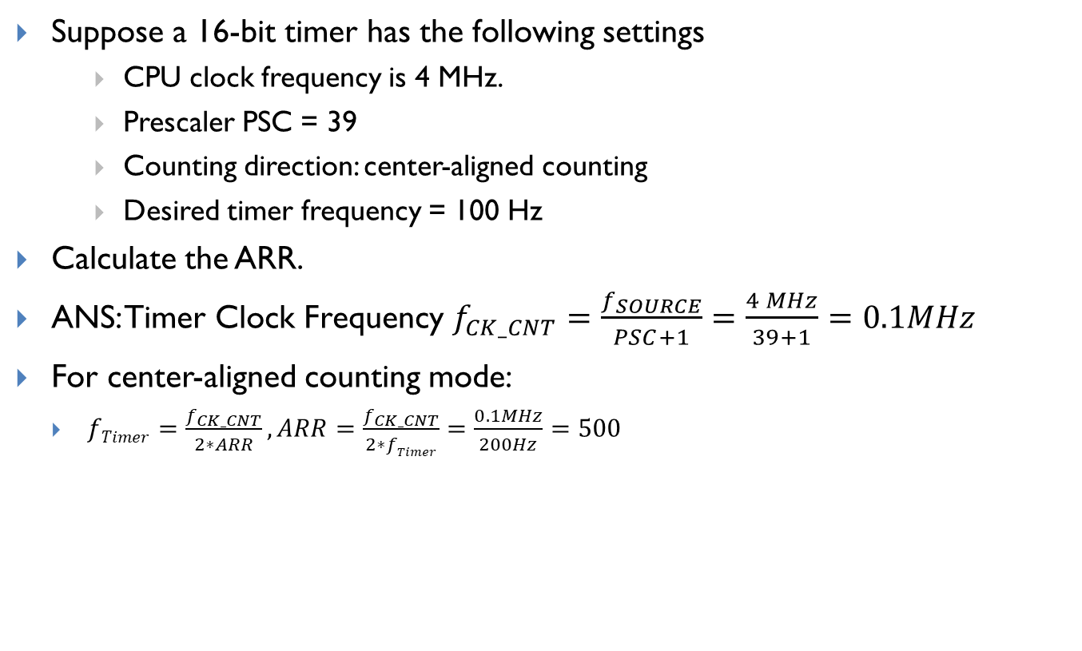
Calculating the ARR
Suppose a 16-bit timer has the following settings
CPU clock frequency is 4 MHz.
Prescaler PSC = 39
Counting direction: center-aligned counting
Desired timer frequency = 100 Hz
Calculate the ARR.
ANS: Timer Clock Frequency $f_{CK_CNT}=\frac{f_{SOURCE}}{PSC+1}=\frac{4 MHz}{39+1}=0.1MHz$
For center-aligned counting mode:
$fTimer=\frac{f_{CK_CNT}}{2∗ARR}, ARR=\frac{f_{CK_CNT}}{2∗fTimer}=\frac{0.1MHz}{200Hz}=500$

Slide 6
Clock Frequency and Timer Frequency
Suppose all registers are 16 bits. CPU clock frequency is 400 MHz.
What is the maximum and minimum Clock Frequency, and Timer Frequency, assuming up-counting mode?

Slide 7
PWM duty cycle
Suppose a 16-bit timer has the following settings
CPU Clock frequency is 16 MHz.
Prescaler PSC = 159
ARR = 1999
CCR = 499
Counting direction: up-counting
Output is set as PWM Mode 2 (High True).
Calculate the timer frequency and PWM duty cycle.

